Slide 1

Banking Services Software
By- Diptish Gohane

Slide 2
MIT-ADT UNIVERSITY
Guided By:-
Presented By:-
Prof. Rahesha Mulla maam
Diptish Gohane

Slide 3

FRONTEND (LANGUAGE USED)
Python

Slide 4
INTRODUCTION mankind.”
Banking services software (BSS) allows customer to perform banking transactions anywhere and at anytime without the need of human teller.
By using account no and password at this software ,individuals can withdraw cash from current or saving accounts, make a deposit or transfer money from one account to anther or perform other functions.
- Neil Armstrong

Slide 5
Goals and Objectives
Customer Satisfaction :-
Client can do his operations comfortably without any risk or losing of his privacy.
Saving Customer Time :-
Client doesn’t need to go to the bank to do small operation.
Protecting The Customer :-
It helps the customer to be satisfy and comfortable in his choices, this protection contains customer’s account, money and his privacy.
Transferring Money :-
Help client transferring money to another bank.

Slide 6
FLOW CHART
START
READ INSTRUCTION
ENTER AC/NO
AND PASSWORD
BANKING SERVICES
DEPOSIT
TRANSFER
PIN CHANGE
OTHER SERVICES
FAST CASH
WITHDRAWL
BALANCE ENQUIRY
MINI STATEMENT
ENTER AMOUNT
ENTER AC/NO
OF FUNDER
ENTER NEW PIN
SELECT
SELECT AMOUNT
ENETR AMOUNT
ENETR AC/NO
ENETR AMOUNT
THANKS
THANKS
THANKS
THANKS
THANKS
THANKS
THANKS
THANKS

Slide 7
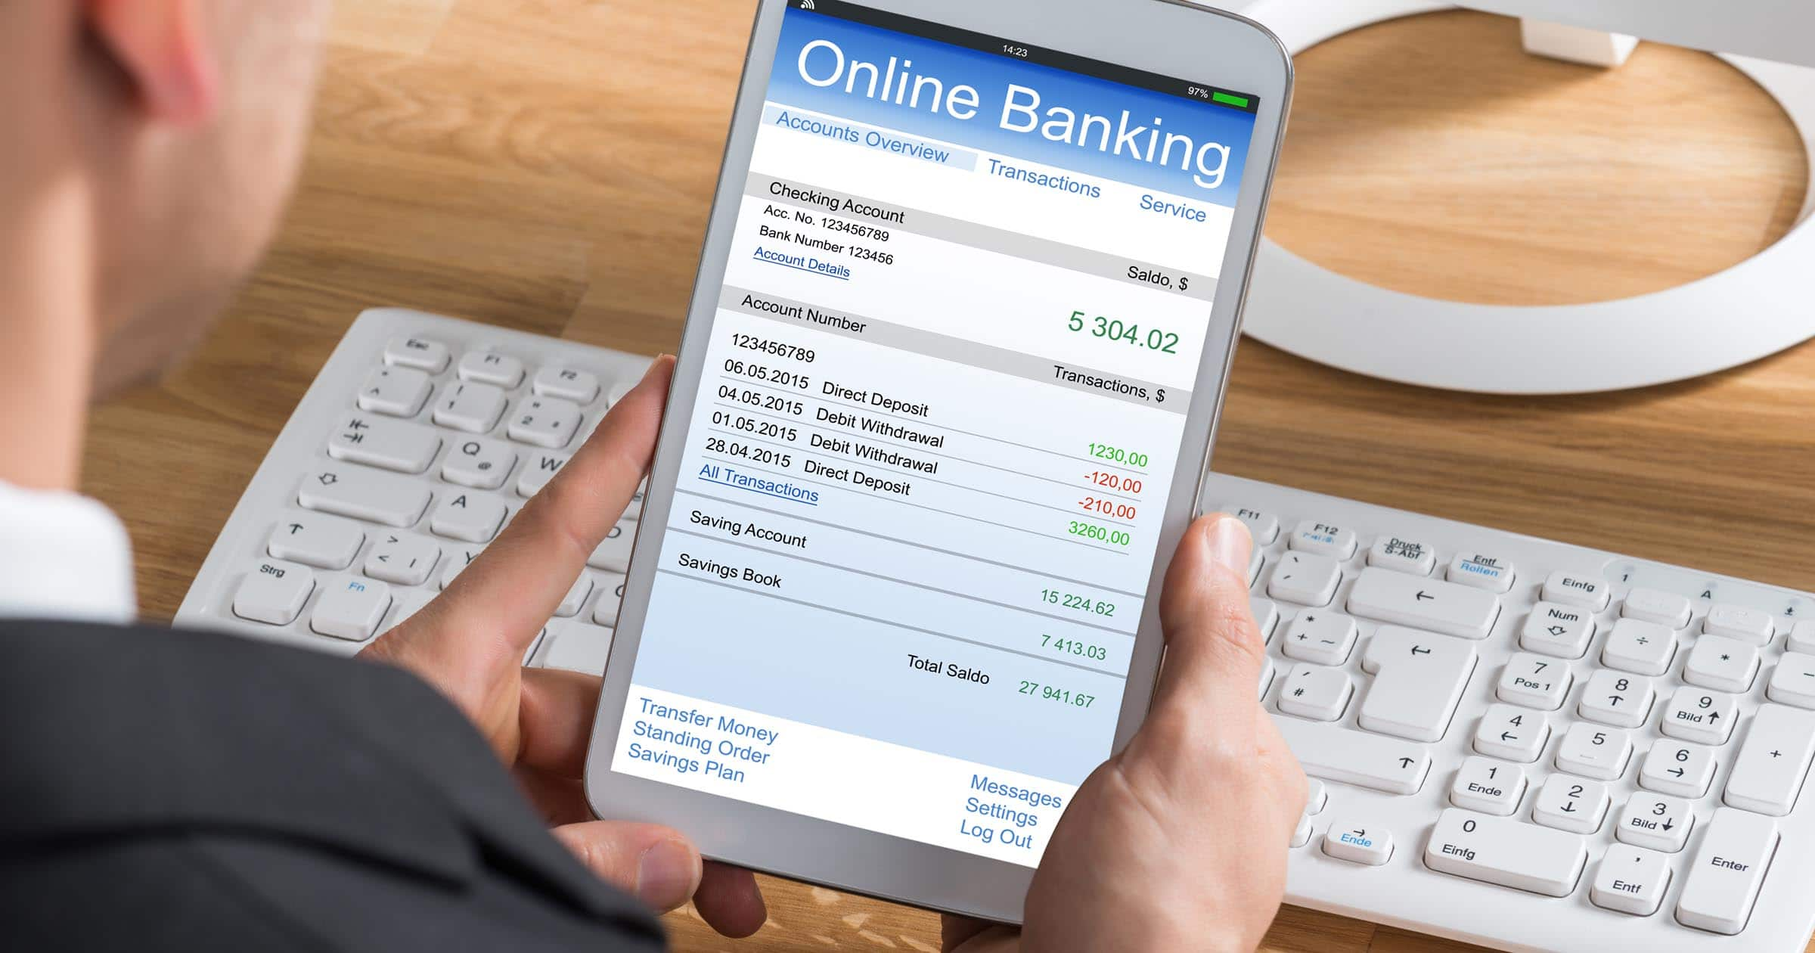
INSTRUCTIONS
1. Enter ac/no and Wait about 10-20 seconds until the software checks. 2. Enter Your PIN, or Personal Identification Number and Press OK.
3. Select option - Banking. 4. Select the Transaction.
5. Allows the Screen to show if You Wish to obtain a receipt or not.
6. Allow Your transaction to be processed. 7. Wait for screen to Show if you Wish to make another Transaction. 8. Take Everything.
9. Check your account number after changing. 10. Fill each and every entry carefully.

Slide 8
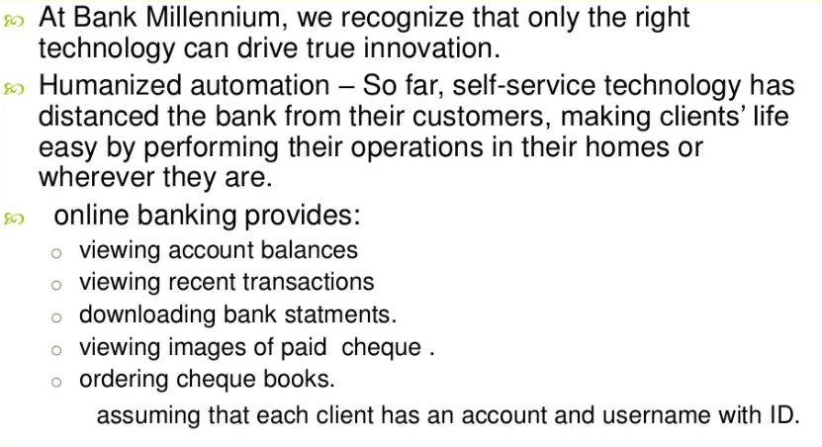
CONCLUSIONankind.”
- Neil Armstrong

Slide 9


